Slide 1
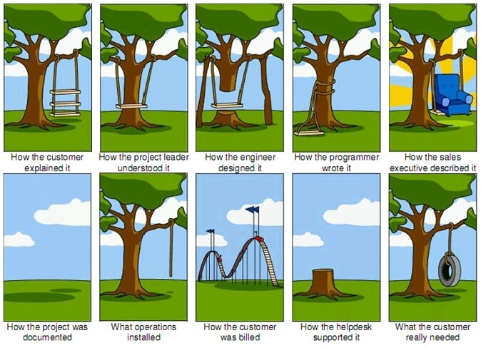

Slide 2
Formal methods
Formal specification is part of a more general collection of techniques that are known as formal methods.
These are all based on mathematical representation and analysis of software.
Formal methods include
- Formal specification
- Specification analysis and proof (specification is checked for consistency)
- Transformational development (if there were any means to take the requirements and verify the
requirements and transform the requirement automatically into the code which is the end product of
the software development process that would ensure that will retain the continuity between various
phases of the development cycle of the software.)
- specification to piece of code
- Persons reading the document and making analysis can have different interpretation, therefore,
there will be human errors
- If all of them can be automated and machine can do finally produce the code and which can
then be verified by the human
- Program verification (to checking or testing to make sure that we have built, it can also be automated, the test case can be generated and applied on final production of the end product to verify the system what we are intended to.)

Slide 3
Acceptance of formal methods
Formal methods have not become mainstream software development techniques as was once predicted
- Other software engineering techniques have been successful at increasing system
quality. Hence the need for formal methods has been reduced.
- Market changes have made time-to-market rather than software with a low error
count the key factor. Formal methods do not reduce time to market. (because want
to make the system without bugs at first go)
- The scope of formal methods is limited. They are not well-suited to specifying and
analyzing user interfaces and user interaction (They are not good at specifying
and analyzing the front end GUI based system but pretty good at backend system)
- Formal methods are hard to scale up to large systems

Slide 4
Use of formal methods
Formal methods have limited practical applicability
Their principal benefits are in reducing the number of errors in systems so their main area of applicability is mission critical systems. (ex: software that runs Avionics and large PLANES)
In this area, the use of formal methods is most likely to be cost-effective

Slide 5
Specification in the software process
Specification and design are inextricably intermingled.
Architectural design is essential to structure a specification.
Formal specifications are expressed in a mathematical notation with precisely defined vocabulary, syntax and semantics.

Slide 6
Specification in the software process
Requirements specification
Formal specification
Requirements definition
High-level design
Done by user in natural language. typically can not be avoided
System modelling
Architectural design

Slide 7
Specification in the software process
Requirements definition can not be avoided as it is in the natural language
Requirements specification can be avoided and straightaway we can jump into the formal specification step (Generally it is not recommended)
High-level design can be generated once we get into the formal specification and different system models driven off from the system specification (for example, UML model can be generated from formal specification and test models can also be generated)

Slide 8
Specification techniques
Algebraic approach
- The system is specified in terms of its operations and their
relationships
-
Model-based approach
- The system is specified in terms of a state model that is constructed
using mathematical constructs such as sets and sequences.
Operations are defined by modifications to the system’s state

Slide 9
Formal specification languages
 | Sequential | Concurrent
Algebraic | Larch (Guttag et. al) OBJ (Futatsugi et. al) | Lotos (Bolognesi)
Model-Based | Z (Spivey et. al) VDM (Jones et. al) | CSP (Hoare) Petri Nets (Peterson)
Concurrency introduces the notion that the multiple modules working at the same time

Slide 10
Use of formal specification
Formal specification involves investing more effort in the early phases of software development
(taking much more time for modeling mathematically but it ease out the later phases because transformational developments is the focus of formal methods whereas manual or man based development is the focus of other software engineering practices.)
This reduces requirements errors as it forces a detailed analysis of the requirements
Incompleteness and inconsistencies can be discovered and resolved
Hence, savings as made as the amount of rework due to requirements problems is reduced

Slide 11
Development costs with formal specification

Slide 12
Properties of Formal Specification
Complete (specification has to be complete and the user definition document will be carried over appropriately)
Consistent (can not be ambiguity in the requirement, ex: one requirement is that fewer chips has to be used that is more chips need to be put in one chip which increases power consumption and the power consumption of each chip should be lower - inconsistency)
Concise (mid-sized projects even run into 100 of pages - verbose)
Unambiguous
Executable (basis for transformational developments – Z, VDM, Larch are directly executable that means that designs can be generated from these specification documents and then designs can be turned into codes automatically and code content can be directly executable if the designer gives green signal
Reusable ( for example, response time of a module that is a non-functional requirements (module calling another module should not take more than 50 millisecond) and this specification can be applicable in variety of applications (for example, applicable in the construction of website). This piece of specification written for some system can be allowed to reuse in the development of other system.
Provides a common language for communication between clients, designers and implements
Has its basis in discrete mathematics
- Set Theory
- Boolean Logic
- Predicate Logic

Slide 13
Library Example – Informal statement
A book can either be in the stacks, on reserve, or loaned out.
If a book is in the stacks or on reserve, then it can be requested.
We want to
1. formalize the concepts and the statements
2. prove some theorems to gain confidence that the spec is correct

Slide 14
Library Example – Formalization -1
Lets first formalize some concepts
- S: the book is in the stacks
- R: the book is on reserve
- L: the book is on loan
- Q: the book is requested

Slide 15
Library Example – Formalization - 2
A book can either be in the stacks, on reserve, or loaned out
- S ˄ ¬(R ˅ L)
- R ˄ ¬(S ˅ L)
- L ˄ ¬(S ˅ R)
If a book is in the stacks or on reserve, then it can be requested
- Q => (S ˅ R)

Slide 16
Library Example – Prove Correctness
A theorem to help validate the spec.
A book on loan cant be requested. L => ¬Q
See if the specification matches our understanding (and vice versa)
Proof by contradiction
- We start out by making one assumption: that the statement is false
- Derive a contradiction
- Since only one assumption was made, it must be wrong (i.e., not
false after all, but rather true)

Slide 17
To Prove L => ¬Q
Step1: ¬ (L => ¬Q) Assume negation
Step2: ¬ (¬L ˅ ¬Q) Rewriting
Step3: L ˄ Q De morgan’s law
Step4: L Simplifying
Step5: ¬(S ˅ R) L ⬄ ¬(S ˅ R)
¬(S ˅ R) => Q Simplifying
=> S ˅ R This is a contradiction. The previous step says not of S ˅ R and later it become S ˅ R
Step1 is incorrect. Therefore, L => ¬Q

Slide 18
Specification Types
Interface Specification (how subsystems are going to interact with each other but not about the details of a particular subsystem by itself)
Behavioral specification (concentrate on the behavior of individual subsystem or individual module but does not concern with the internals of the subsystem)

Slide 19
Interface Specification
Large systems are decomposed into subsystems with well-defined interfaces between these subsystems (how a module is built or how it does none of the concerns)
i. It deals with Operations
i1. return type
i2. parameters
i3. name
-Module contains different operations
-Sum of all the operational specification wrote out is the Interface specification
Specification of subsystem interfaces allows independent development of the different subsystems
Interfaces may be defined as abstract data types or object classes
The algebraic approach to formal specification is particularly well-suited to interface specification ( interface does not concern a state)

Slide 20
Behavioral specification
Algebraic specification can be cumbersome when the object operations are not independent of the object state
Model-based specification exposes the system state and defines the operations in terms of changes to that state
The Z notation is a mature technique for model-based specification. It combines formal and informal description and uses graphical highlighting when presenting specifications

Slide 21
Key points
Formal system specification complements informal specification techniques
Formal specification are precise and unambiguous. They remove areas of doubt in a specification.
Formal specification forces an analysis of the system requirements at an early stage. Correcting errors at this stage is cheaper than modifying a delivered system.

